Slide 1


Using networkx to QA and analyse Price Review models
Hanif Jetha
March 2023

Slide 2
What I’ve been doing
Making a simple script using networkx (NetworkX — NetworkX documentation) (and some other packages) to map and analyse Excel analytical model networks
In Price Reviews Ofwat creates a bunch of analytical models for the end goal of setting price controls.
[PR19 example]
This collection of models can be interpreted as a network since they are connected (or should be connected) by Fountain F_Input and F_Output sheets
At PR19 mapping and QA was done manually. This is unnecessary since all fo the information on how data is transferred between models is in the Fountain sheets. Just get a computer to do it.
The aim is to create a script that can do the mapping and other QA tools automatically and quickly – freeing up analysts to do analytical work and finding problems early

Slide 3
Di graphs and networkx
Using networkx we can make a directed graph showing the connection between models. A Graph (non directed) or DiGraph(directed flows) consist of nodes and edges. These are often used for practical real world applications such as infrastructure networks but can exist in less obvious places as well.
Networkx can then carry out useful analysis such as:
Identifying circularity
Drawing the network (kinda)
Work out the running order for the models
Finding unused inputs and outputs
Digraph is made by looping through all of the Excel files in a folder and extracting the F_Inputs and F_Outputs into lists. These are then looped through to create nodes and edges in the Digraph.

Slide 4
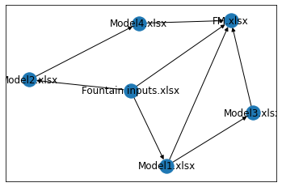
Digraph example

Slide 5
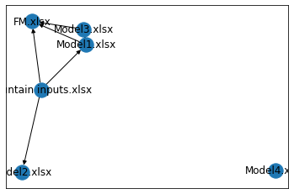
Disconnected model example
This example shows a model that is disconnected from the rest of the digraph.

Slide 6
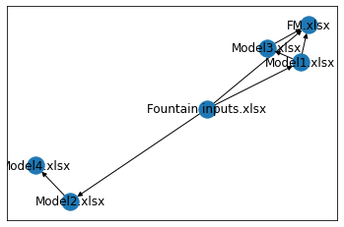
Loose end example
This example shows a model that does not connect to the FM

Slide 7
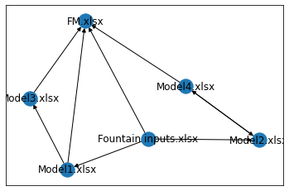
Circularity example
Model 2 and Model 4 are circular. This shouldn’t happen in a PR.
Double ended arrow denotes circularity

Slide 8
Future possibilities
Some future developments that are possible
Working out batches for running models and/ or the order of running models.
Cleaning up the input process to run of a list of models rather than extracting all xlsx files (can easily create errors)
Include STATA files
Improved graphing (maybe)
Modularising the script into functions

